Slide 1
Ggplot2 & Plotly

Slide 2
ggplot2
https://ggplot2.tidyverse.org/

Slide 3
What is ggplot2?
Ggplot2 is the premiere visualization package for R
Created by Hadley Wickham, Winston Chang, Kara Woo, Thomas Lin Pedersen, Claus Wilke and Kohske Takahashi
It can create just about any chart you can conceive of.

Slide 4
Setting up a plot
ggplot()
Arguments:
data: Dataframe/tibble you’re visualizing
aes(): place the following arguments inside here for grouping, outside for the same thing
x: column for X coordinate
y: column for y coordinate
group: column to group information by
color/fill: color or column to group colors by
shape: shape or column to group shapes by
alpha: opacity or column to set opacity

Slide 5
Chart Types today
Bar charts – geom_bar()
Scatter plots – geom_point()
Correlation – geom_smooth()
Histogram/Density – geom_histogram()/geom_density
Boxplot/violin plot – geom_box()/geom_violin()
Time series - geom_line()

Slide 6
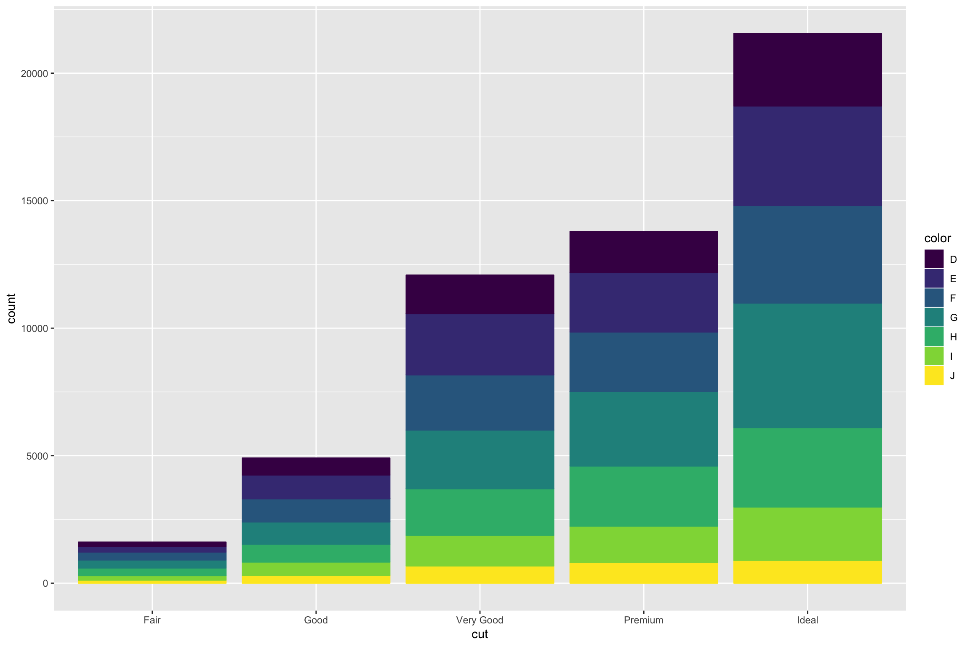
Bar chart

Slide 7
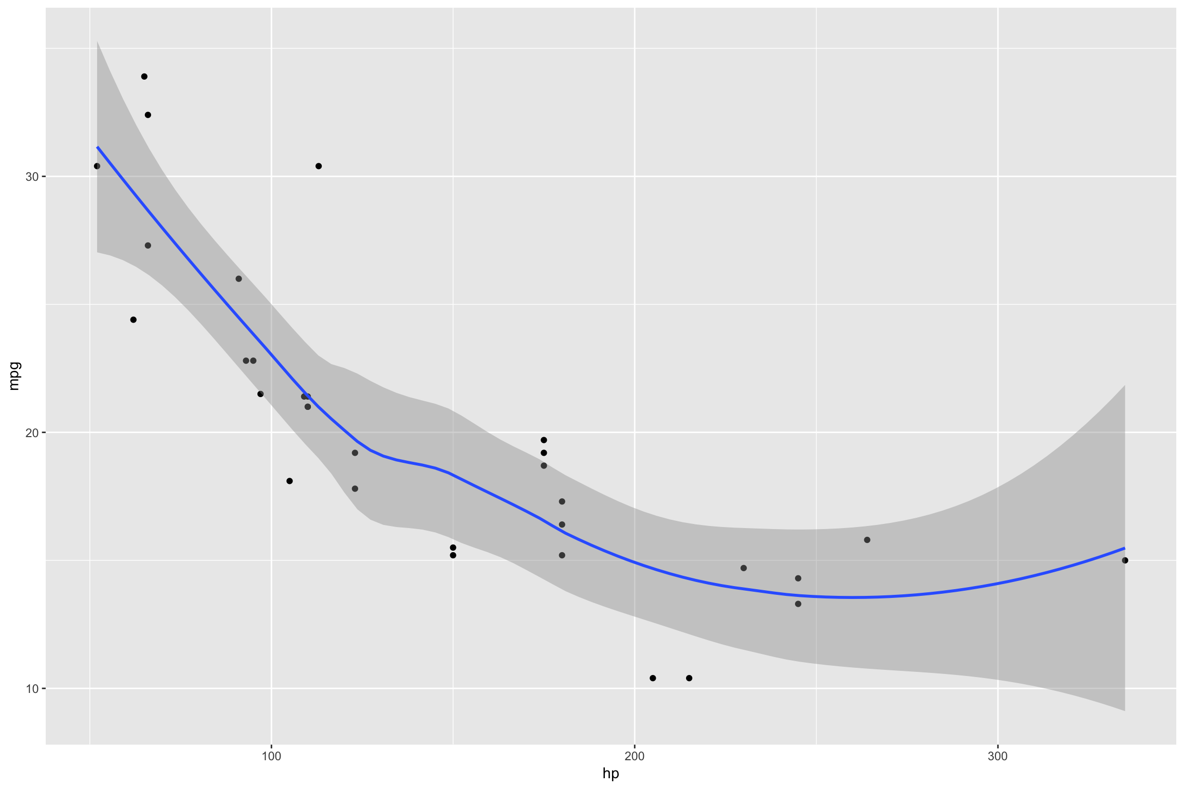
Scatter Plot

Slide 8
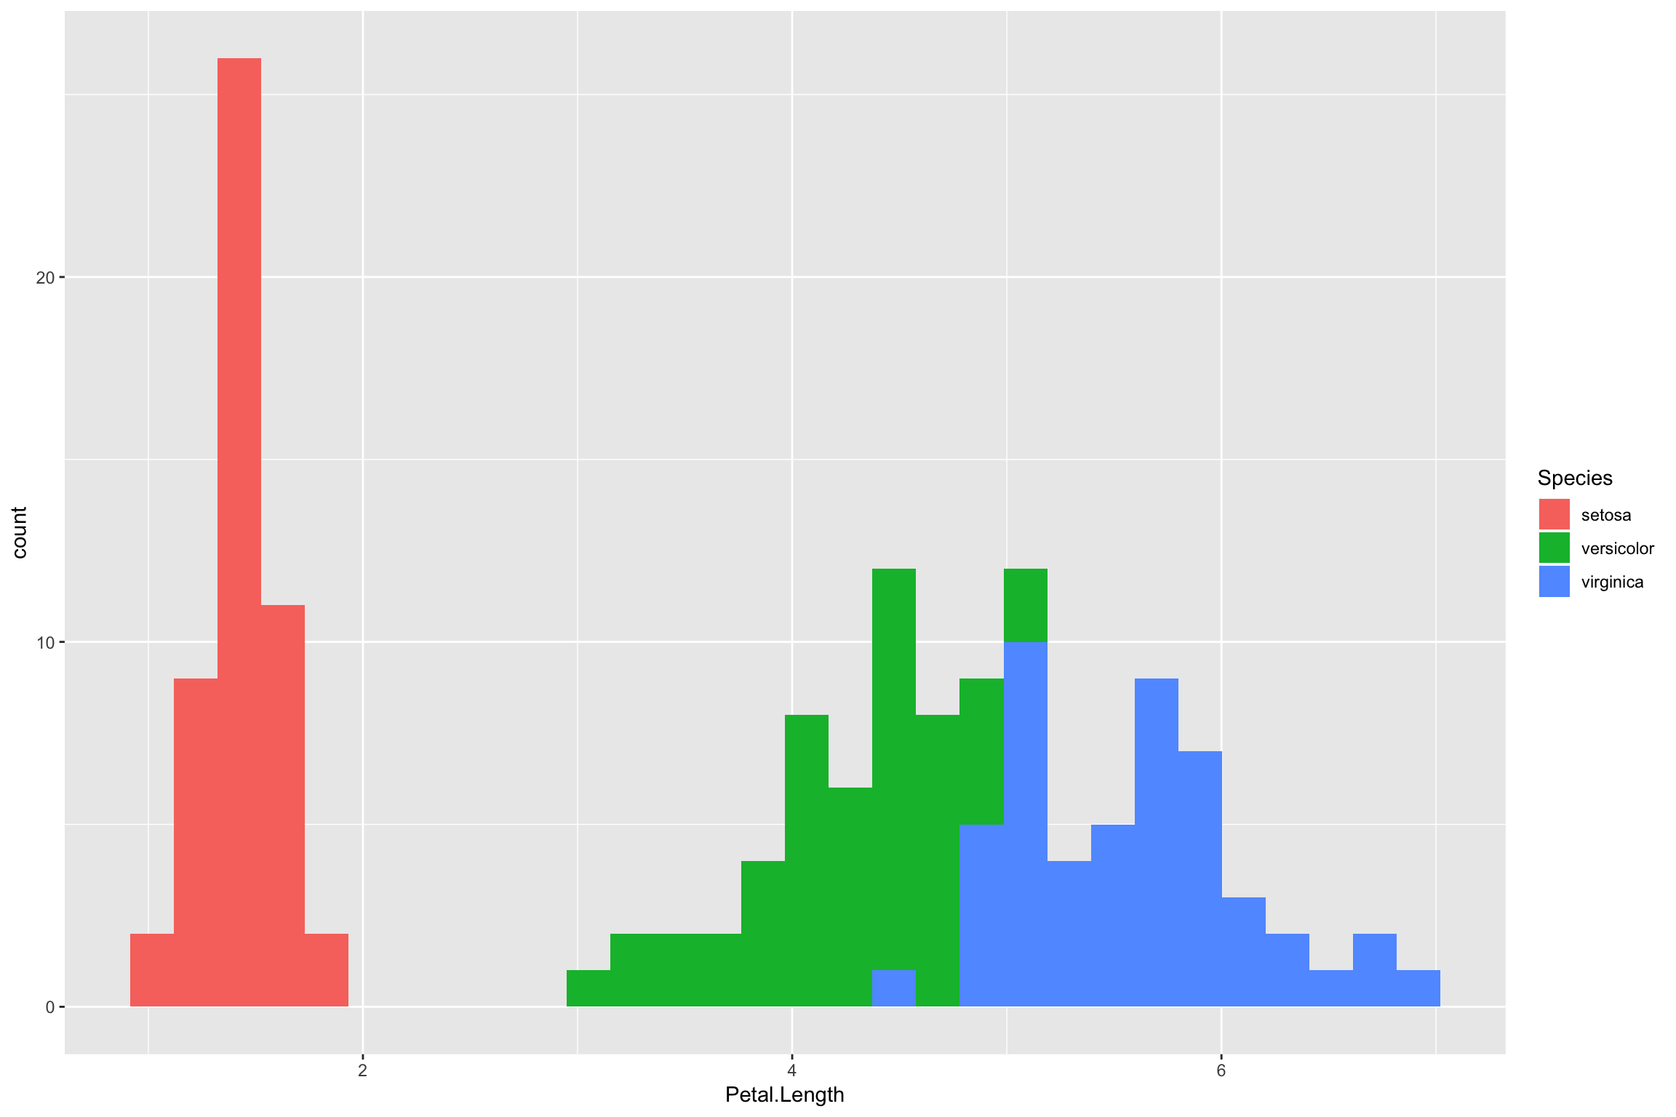
Histogram

Slide 9
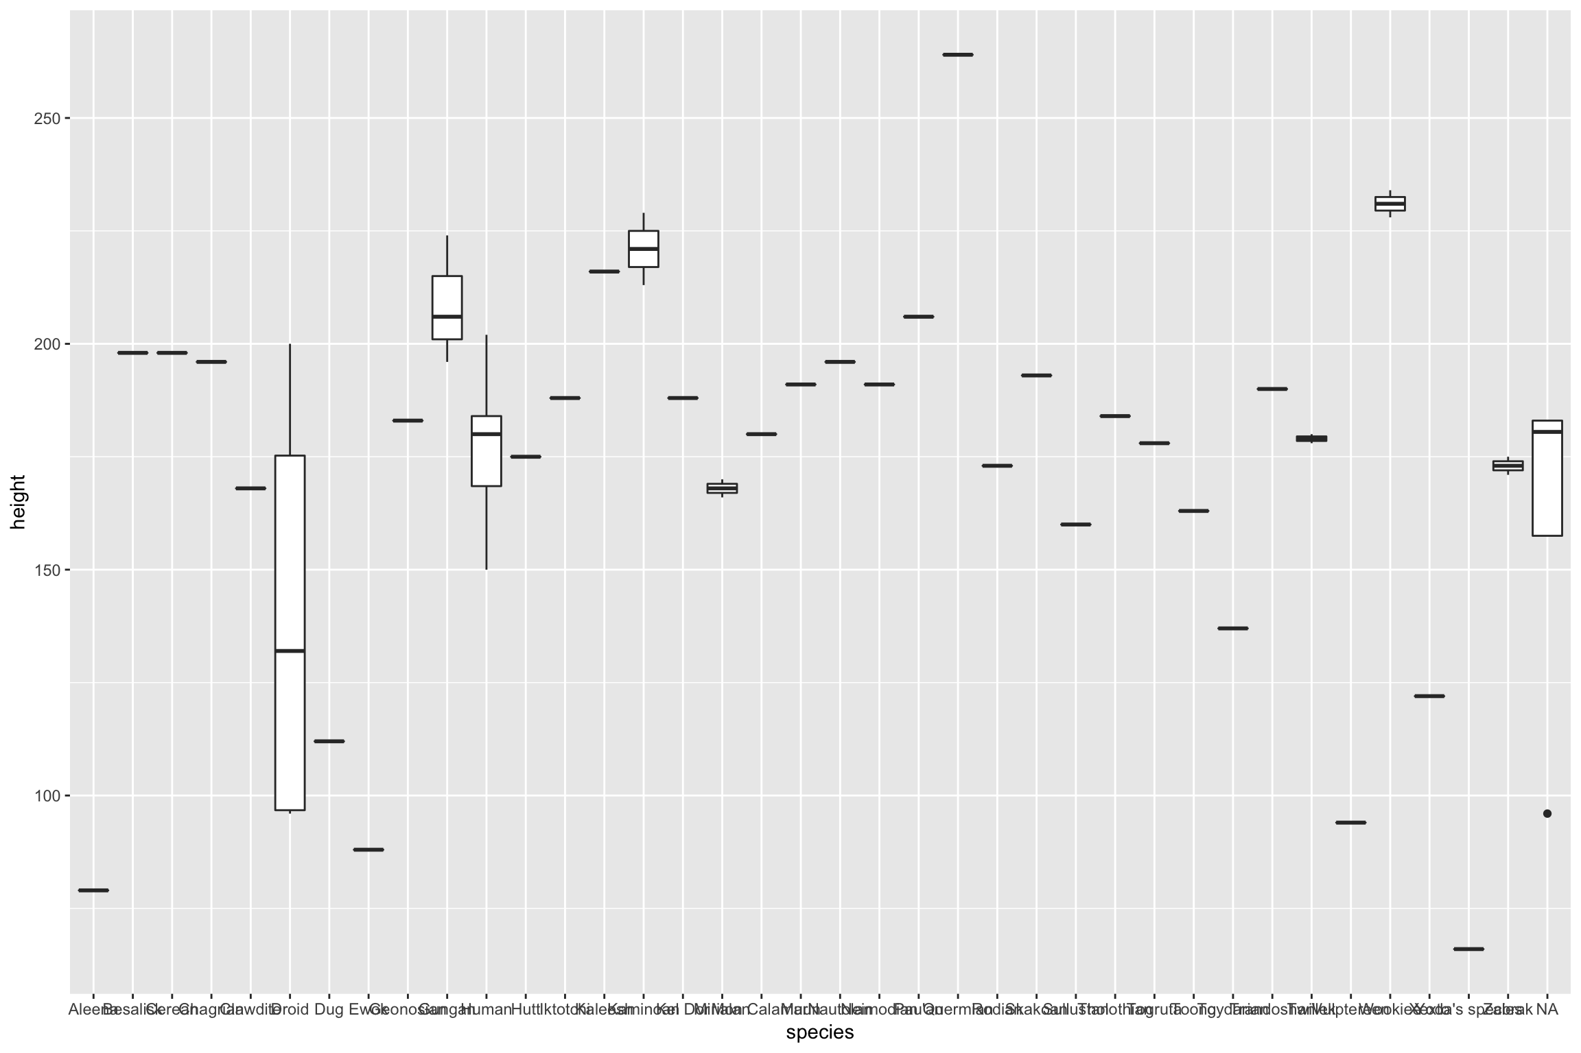
Boxplot

Slide 10
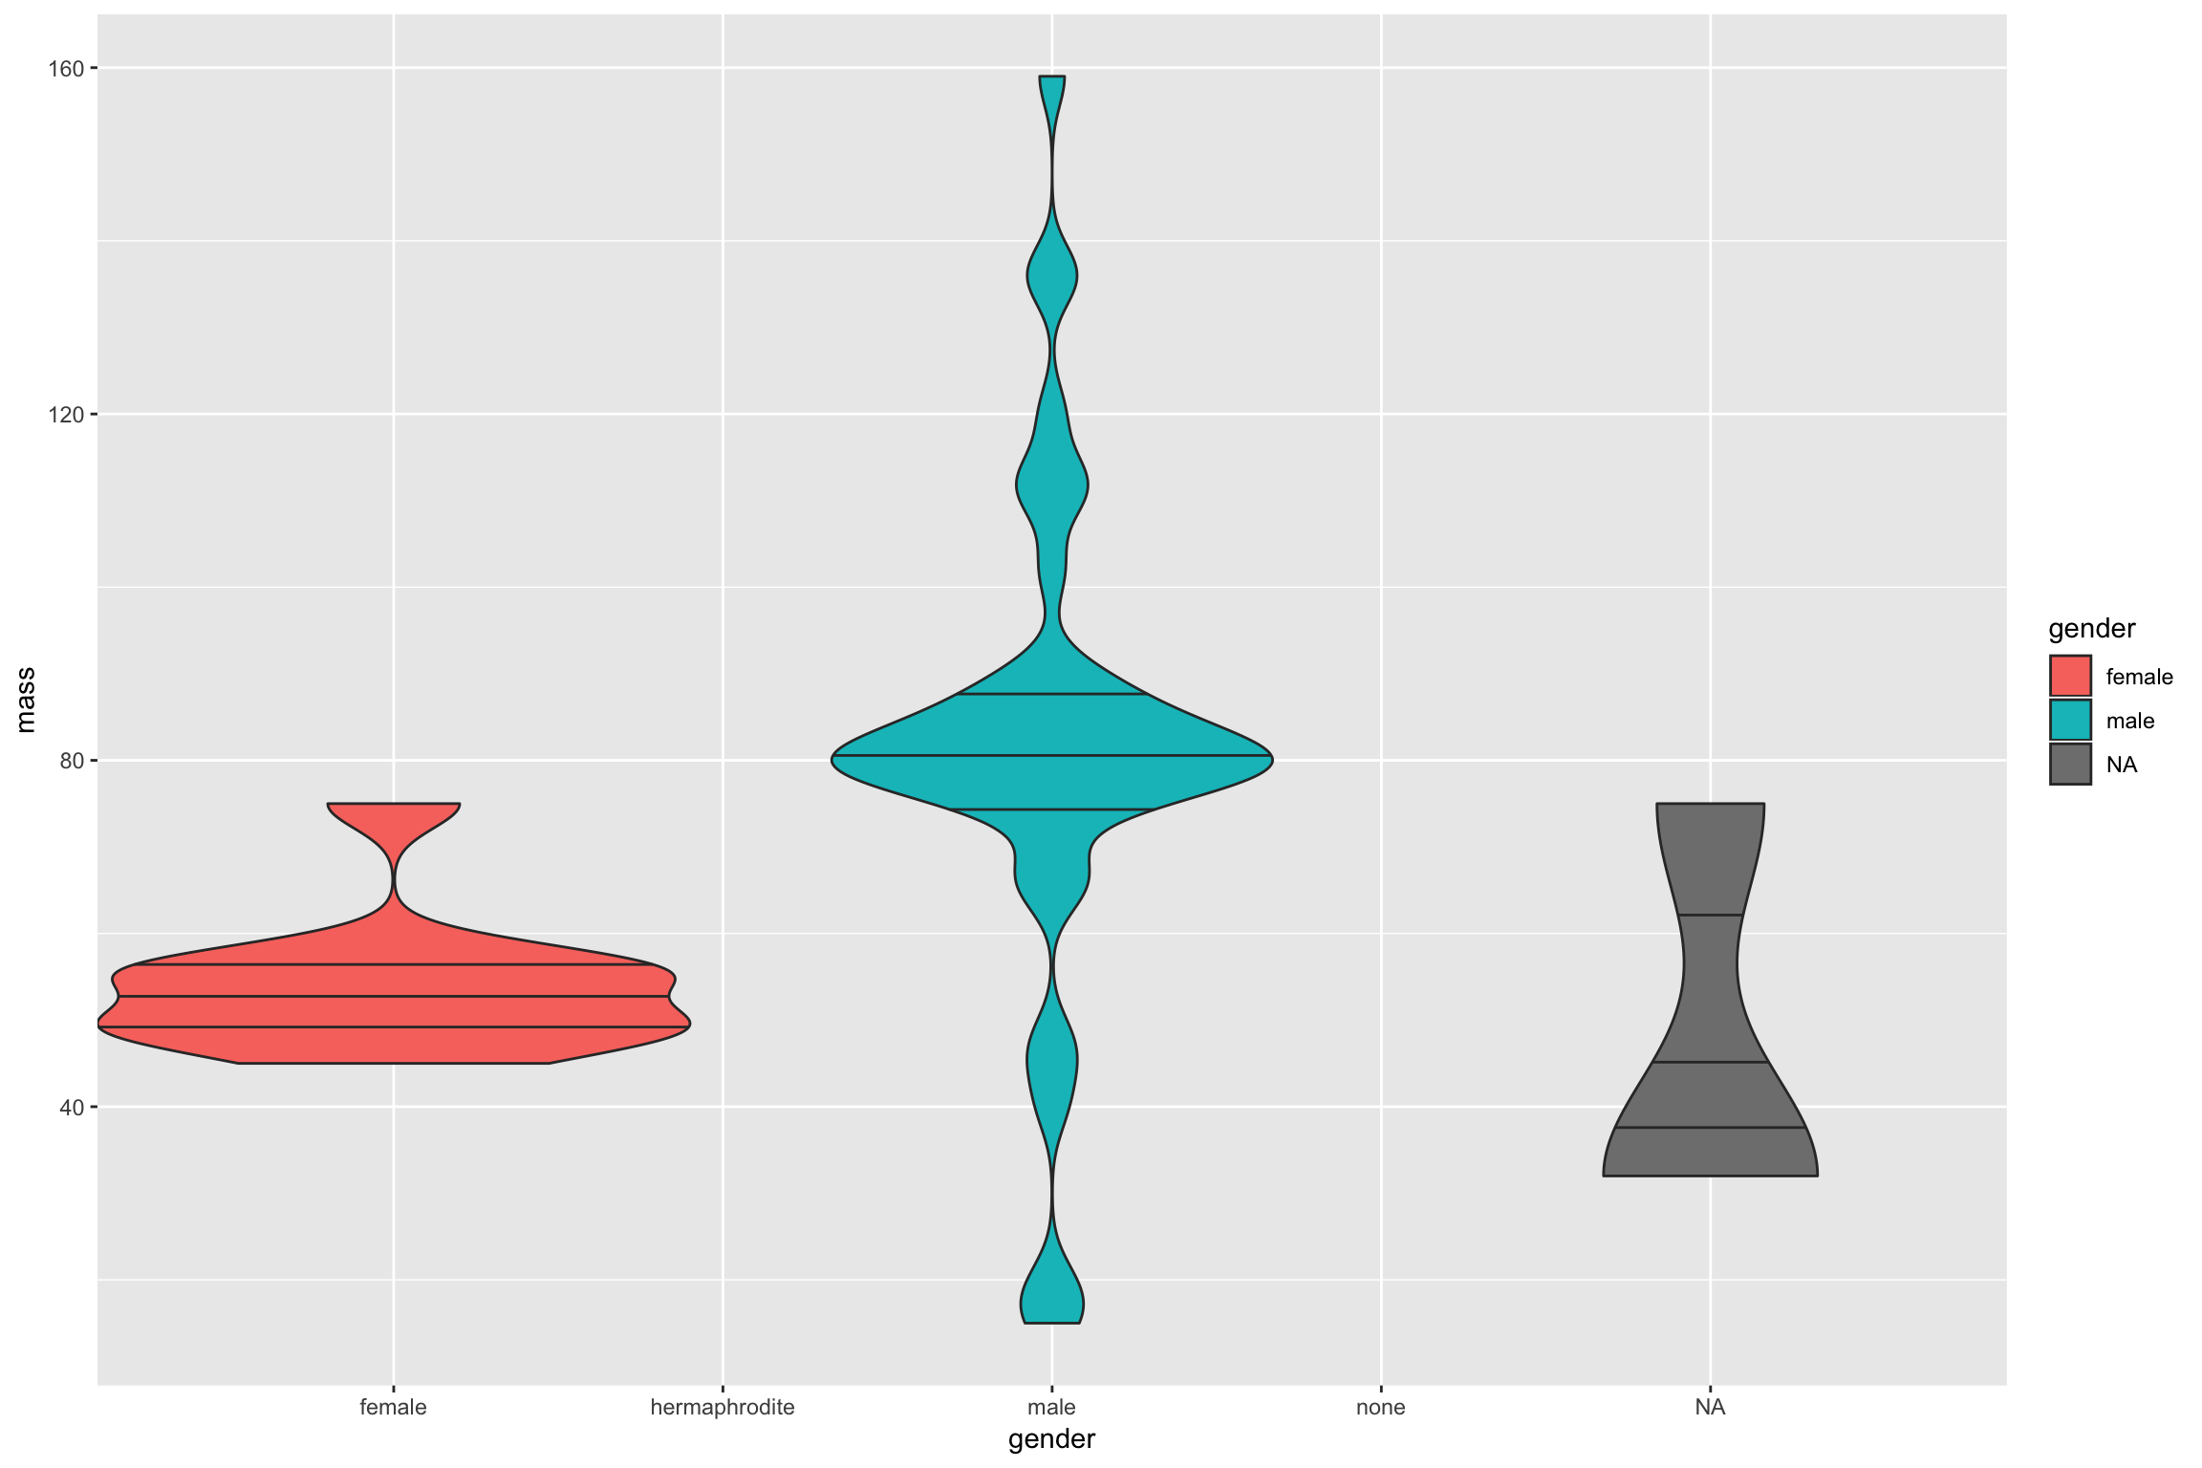
Violin

Slide 11
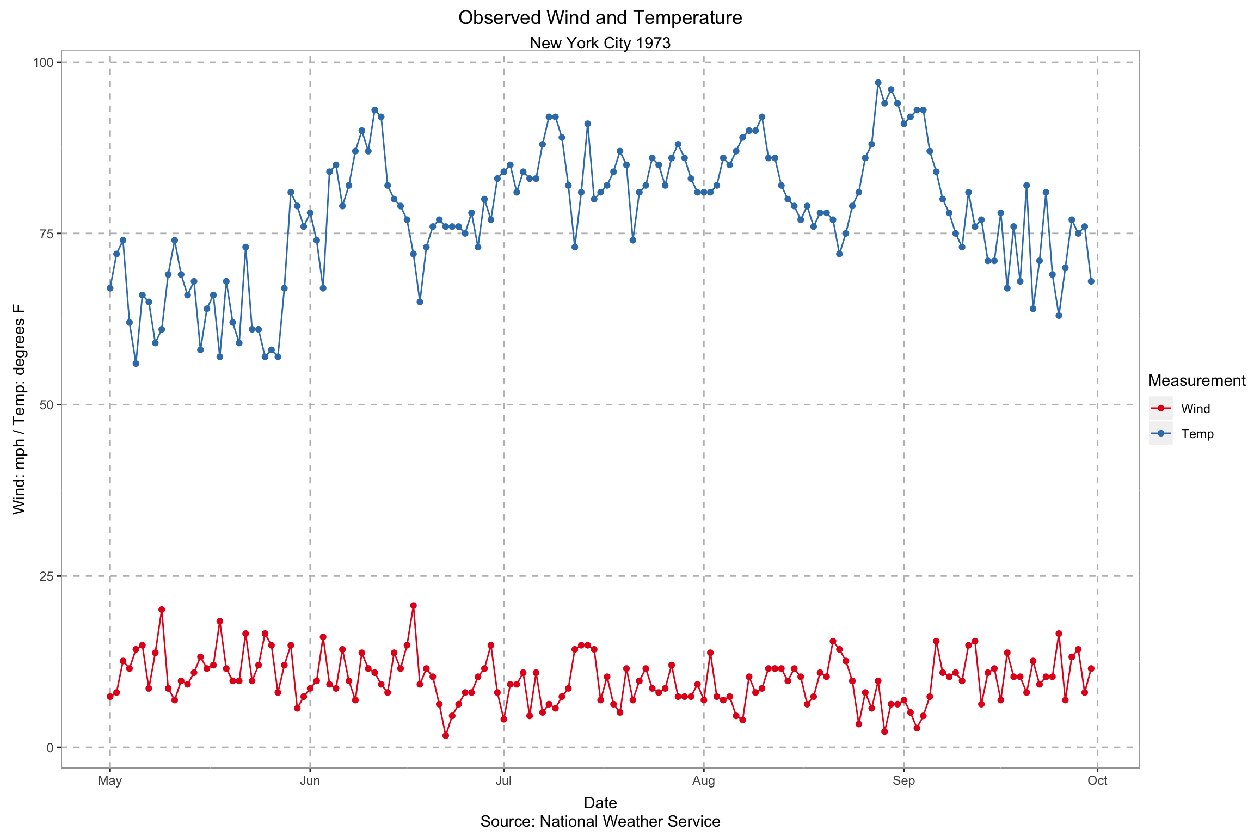
Time Series

Slide 12
Other ggplot concepts
Axis and Guides Labels
Colors
Themes
Facet wrapping
Add single lines: geom_hline()/geom_vline()
Adding labels: geom_text()

Slide 13
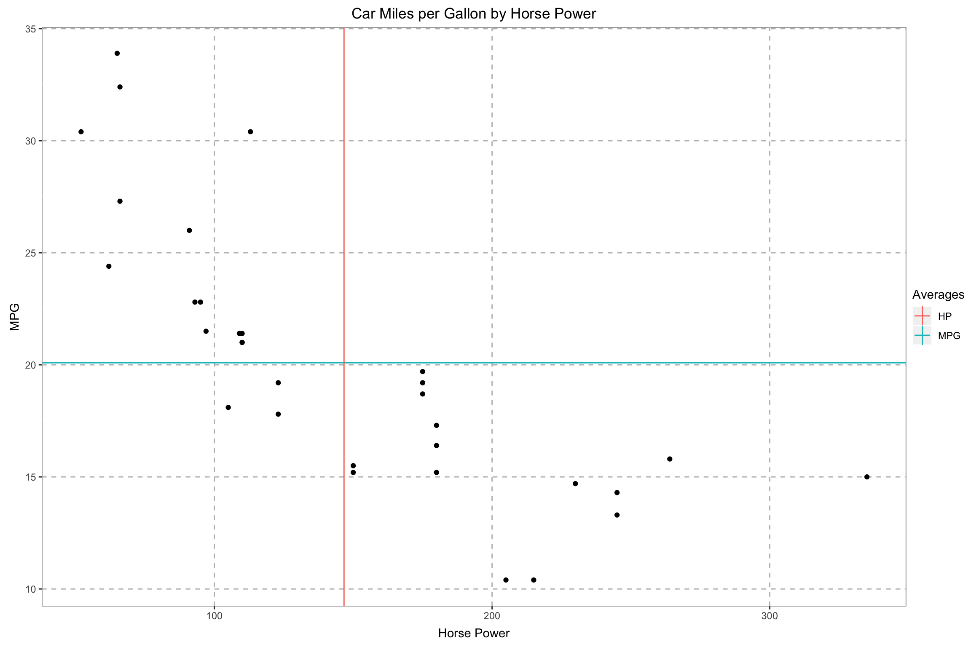
Lines

Slide 14
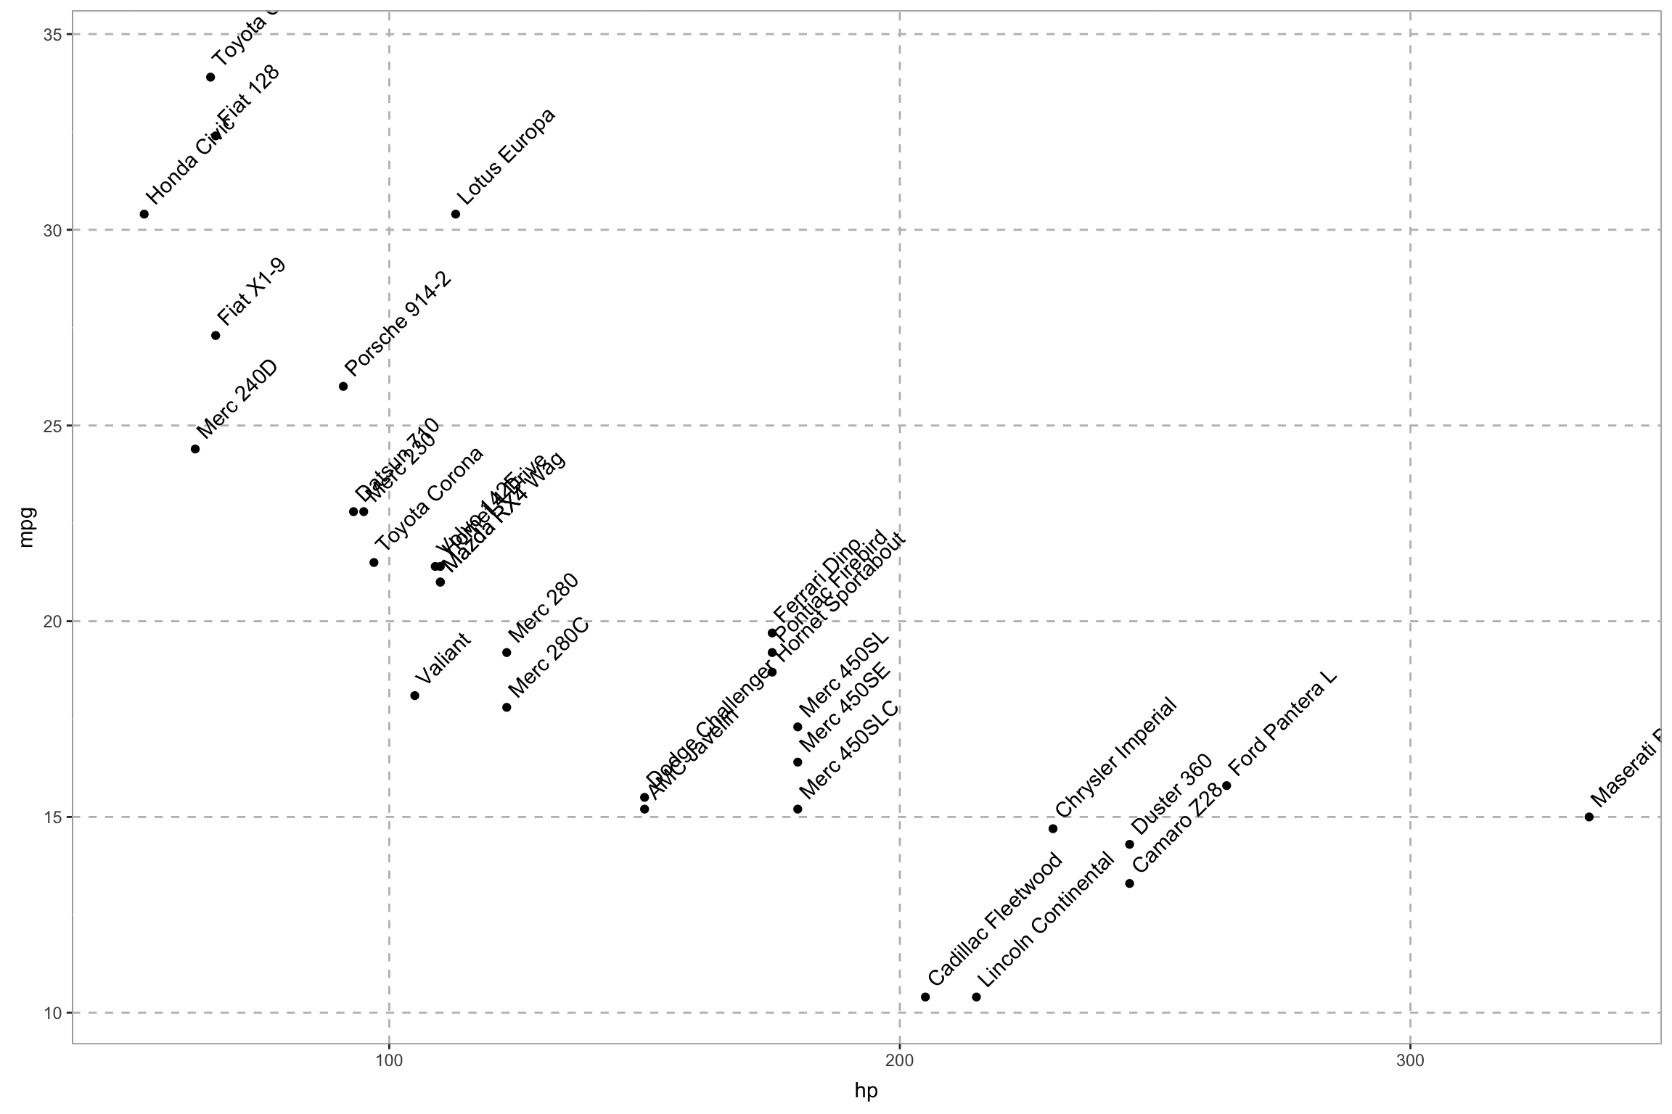
Labels

Slide 15
http://colorbrewer2.org/

Slide 16
plotly
https://plot.ly/r/

Slide 17
Wrap it
ggplotly(
# Your ggplot2 code here!
)

Slide 18
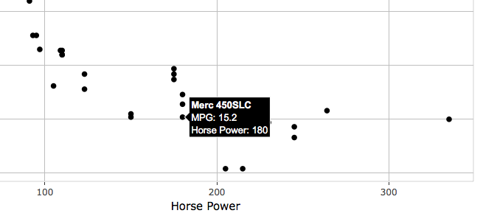
Custom tooltip
ggplotly(
ggplot(mtcars, aes(x = hp, y = mpg, text = paste("<b>”, rowname, "</b><br>",
"MPG:", mpg, "<br>Horse Power:", hp))) +
geom_point() +
ggtitle("Car Miles per Gallon by Horse Power") +
xlab("Horse Power") +
ylab("MPG"),
tooltip = "text"
)

